Slide 1
Lecture 15
Keys
Mutating Joins
Duplicate Keys
Strings

Slide 2
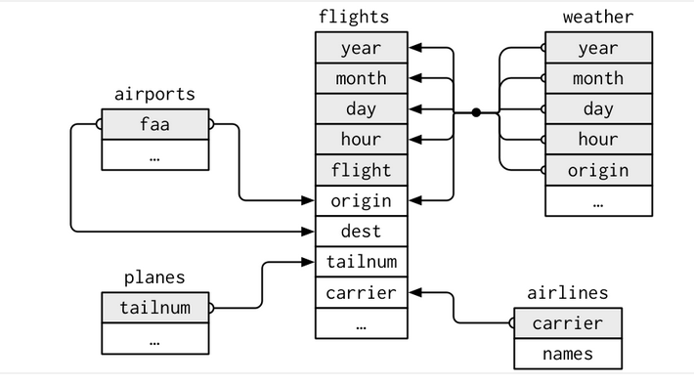
Keys
Keys are variables used to connect two tables
  Key is a variable (or variables) that uniquely identifies an observation
  Examples: Each plane is uniquely identified by its talinum
  Each observation in weather is identified by 5 variables - year, month, day, hour, and origin.
Two types of keys
  Primary key – uniquely identifies an observation in its own table, e.g., planes$tailnum
  Foreign key – uniquely identifies an observation in another table, e.g., flights$talinum
  A variable can be both a primary and foreign key, e.g., origin is primary key in weather a foreign key for airport

Slide 3
Keys
What happens when there is no primary key?
  Can add a key using mutate( )
  Surrogate key – key added when there is no primary key
  13.3.1 Exercises
  1. Add a surrogate key to flights.
  Solution
  Can add Add the column flight_id as a surrogate key.
  Sort the data prior to making the key (even though it is not strictly necessary) so the order of the rows has some meaning.
  flights %>%
  arrange(year, month, day, sched_dep_time, carrier, flight) %>%
  mutate(flight_id = row_number()) %>%
  glimpse() ## glimpse() is a transposed version of print()

Slide 4
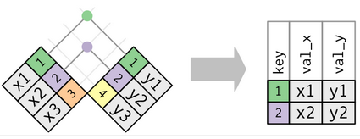
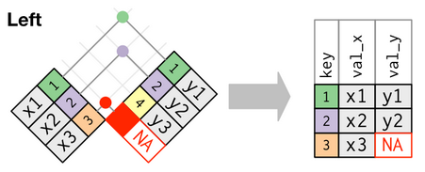
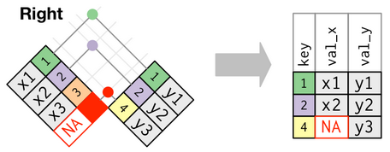
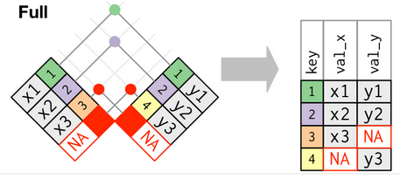
Mutating Joins
Mutating joins add columns from y to x, matching observations based on unique keys
  If a row matches multiple rows in y, then all the rows in y will be returned for each matching row in x.
  There are four types of mutating joins:
  1. Inner join 2. Left outer join
  3. Right outer join 4. Full outer join

Slide 5
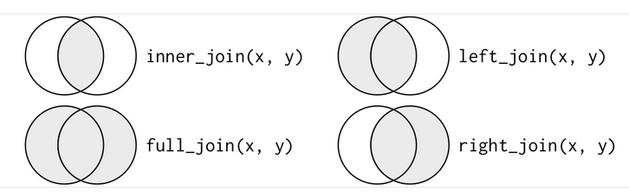
Venn Diagram Depiction of Mutating Joins
  inner_join(x, y, by=“key”)
  left_join(x, y, by = “key”)
  full_join(x,y. by = “key”)
  right_join(x, y, by = “key”)

Slide 6
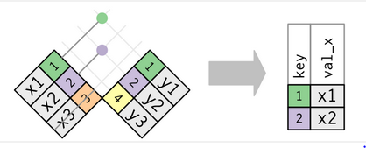
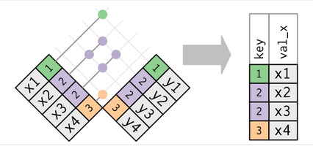
Filtering joins
Filtering joins match observations in way as mutating joins, but affect the observations, not the variables
semi_join(x,y) keeps all observations in x that have a match in y
anti_join(x,y) drops all observations in x that have a match in y
.

Slide 7
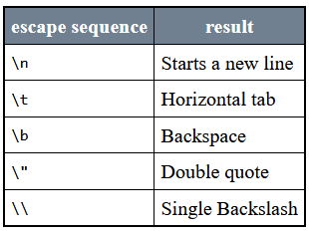
Strings
Package for string manipulation: stringr
  library(tidyverse)
String basics
  R character string – “sting”
  string1 <- "This is a string"
  string2 <- 'If I want to include a "quote" inside a string, I use single quotes’
  Most characters can be used in a string, with a few exceptions, like back slash character, “\”
Escape Characters

Slide 8
Convert numeric values to a string
paste() function
  Converts a numeric value to a string
  paste(5)
  [ ] “5”
  This function can be used to concatenate
  > paste(c("A","B","C"),c("1","2","3"))
  [1] "A 1" "B 2" "C 3“
  Note that a single space is inserted between each letter and number.
paste0()
  No space between the letters and numbers
> paste0(c("A","B","C"),c("1","2","3"))
[1] "A1" "B2" "C3"

Slide 9
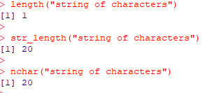
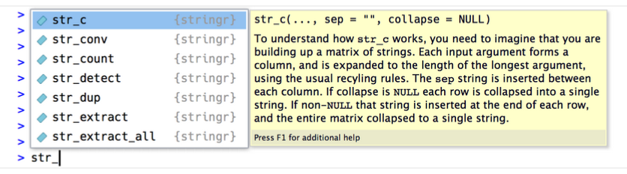
str_prefix
str_length( )
  Tells the number of characters in a string
  str_length(c("a", "R for data science", NA))
  #> [1] 1 18 NA
Combining Strings: str_c( )
  str_c("x", "y")
  #> [1] "xy"
  str_c("x", "y", "z")
  #> [1] "xyz"
  str_c("x", "y", sep = ", ") ## Use the sep argument to control how they are separated
  #> [1] "x, y"

Slide 10
str_prefix
String subsetting: str_sub( )
  Takes start and end arguments (inclusively)
  x <- c("Apple", "Banana", "Pear")
  str_sub(x, 1, 3)
  #> [1] "App" "Ban" "Pea“
  # negative numbers count backwards from end
  str_sub(x, -3, -1)
  #> [1] "ple" "ana" "ear"
  # works even when the string is too short
  str_sub("a", 1, 5)
  #> [1] "a"
Locales
  str_to_lower()
  str_to_upper()
  str_to_title()

